Slide 1


Slide 2

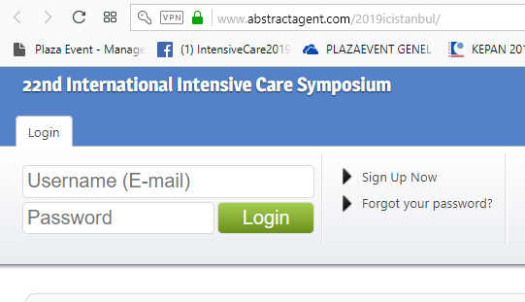
Log in
Please go to website: https://www.abstractagent.com/2019icistanbul/
Enter your Username (e-mail) and Password, then click «Login»

Slide 3
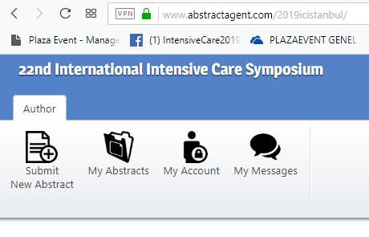
Open Your Abstracts
On your page, click on «My Abstracts» to see your submitted abstracts.

Slide 4
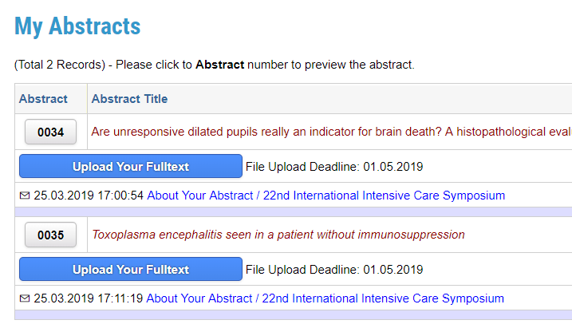
Upload Your Presentation
In the «My Abstracts» page, please click on «Upload Your Fulltext» button under the Abstract you want to upload your presentation.

Slide 5
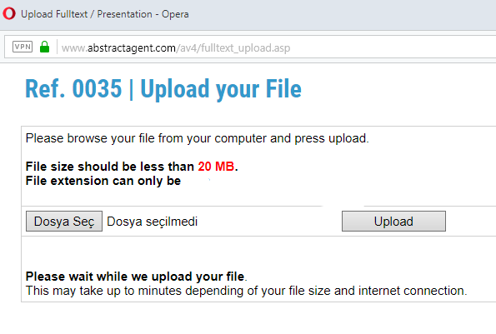
Upload Your File
After clicking «Upload Your Fulltext» button, a new window will be opened. On this window, please click on «Choose File (‘Dosya Seç’ for Turkish users)» button.
Please pay atttention that the file you want to opload cannot exceed 20MB file size.
Only .ppt, .pptx, and .pps files are supported.

Slide 6
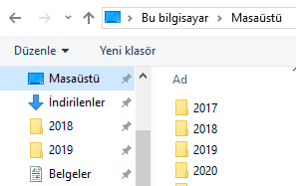

Choose your file
Locate your presentation file on your computer. Choose your file and click «Open (‘Aç’ for Turkish users)».
Then, click on «Upload» file to upload your presentation.

Slide 7
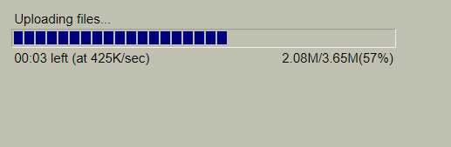
Uploading…
Please wait while your file being uploaded…

Slide 8
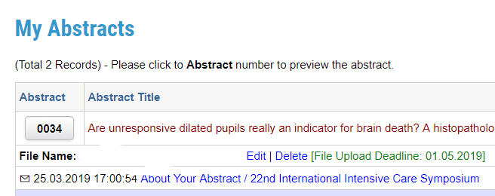
Edit your file
You can edit your presentation until 1st of May, 2019 by clicking «Edit» button found on «My Abstracts» page.

Slide 9


